Slide 1

Near real-time insights with Azure Synapse Link for SQL
Azure SQL Database
SQL Server 2022

Slide 2
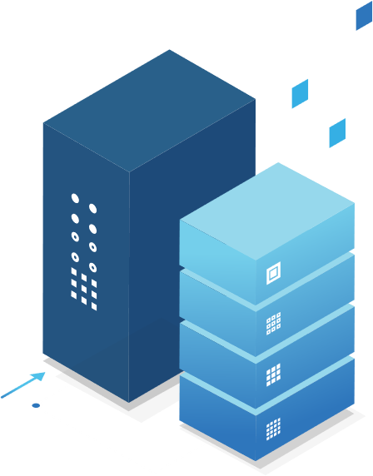

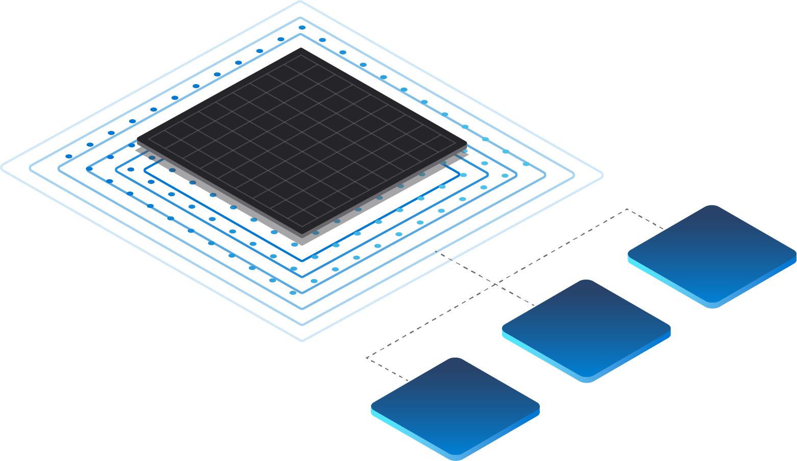


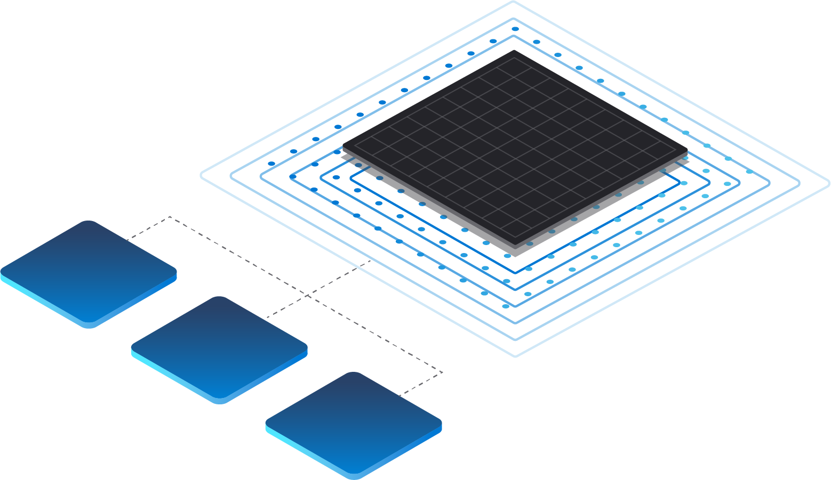



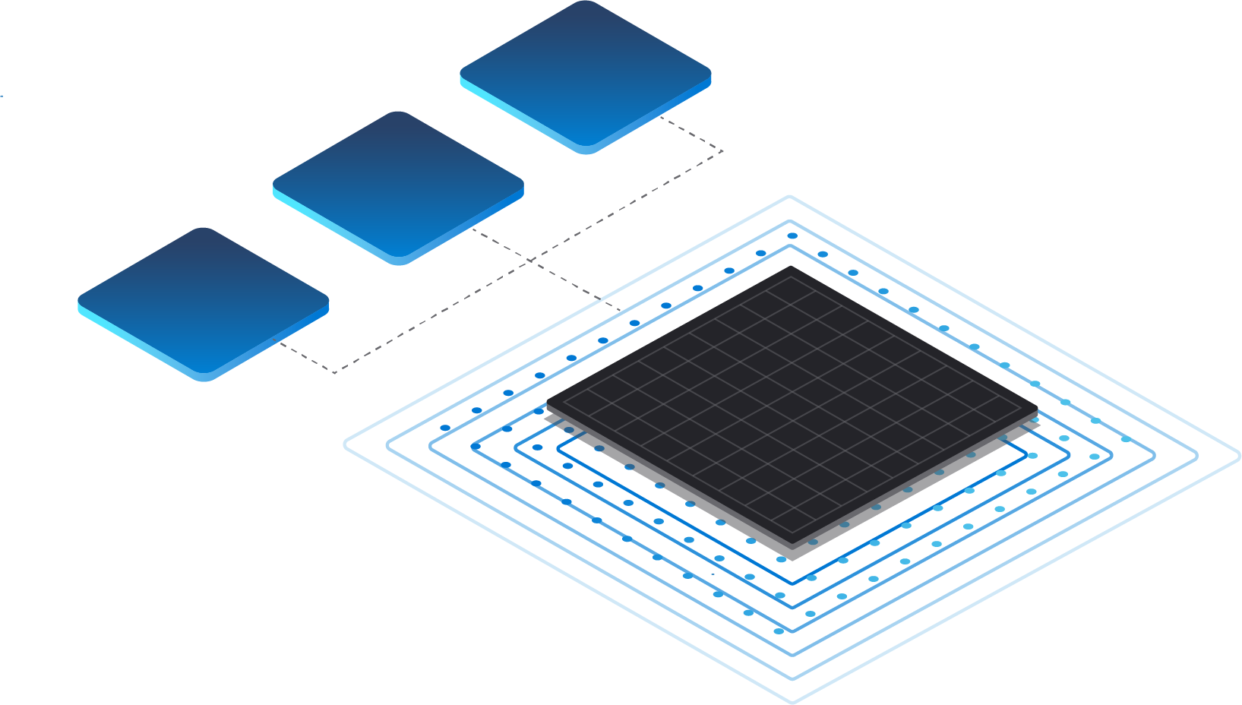


Preparing data to be analytics-ready requires various processes
Operational Databases
Operational Databases
EXTRACT
TRANSFORM
LOAD
Business Apps

Slide 3


These processes result in additional issues that stall data insights
Operational Databases
Operational Databases
EXTRACT
TRANSFORM
Data Pipelines
LOAD
Analytics Destination
Business Apps

Slide 4
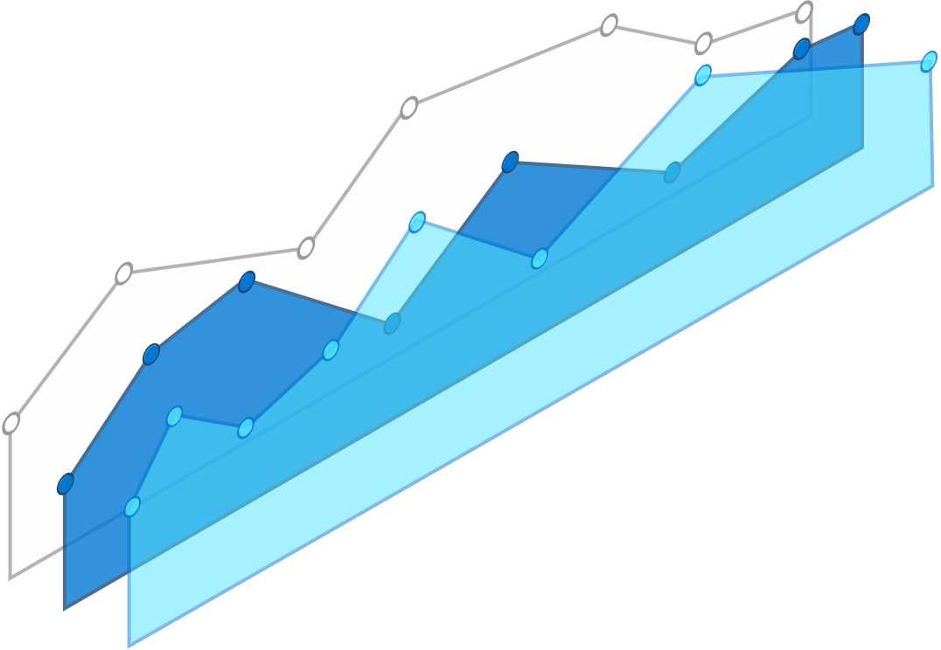







Azure Synapse Link
Azure Synapse Link
for Cosmos DB
Azure Synapse Link
for SQL
Operational Databases
Operational Databases
No managed ETL
Built for convergence
Power BI
Near real-time analytics
Azure Synapse Link
for Dataverse
Azure Synapse Analytics
Business Apps
Notes:
No data integration pipelines required
Latency <90s at 99th percentile
Near real-time insights on transactional data with no performance impact
1-click experience for Power BI dashboard

Slide 5

Azure Synapse Link
Go from after-the-fact analysis to near real-time insights by eliminating barriers between data and analytics. Automatically move data from both operational databases and business applications without time-consuming ETL. Deliver critical insights by easily connecting separate systems, bringing the power of analytics to every data-connected team.

Slide 6



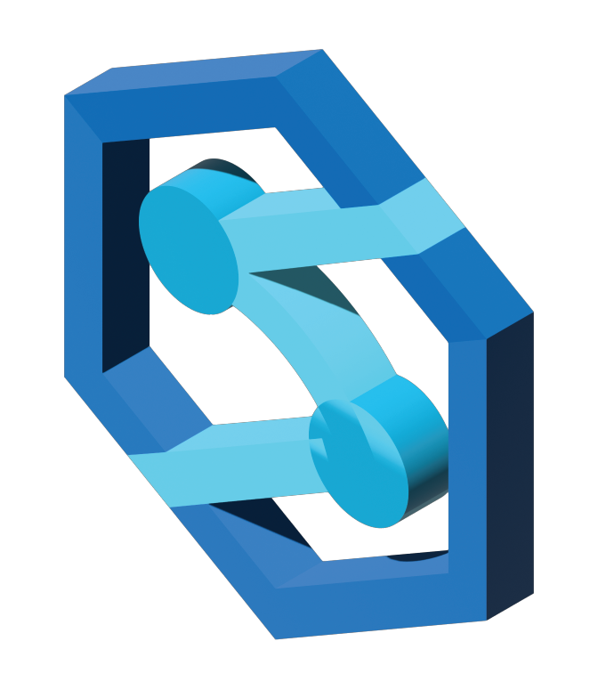
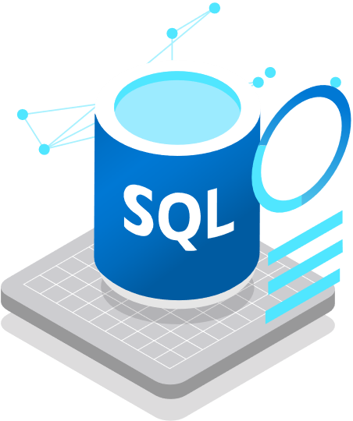

Azure Synapse Link
for SQL
Operational Databases
SQL Server 2022
Azure Synapse Link for SQL
Azure Synapse Link
for Dataverse
Azure SQL Database
Operational Databases
Business Apps
Azure Synapse Link for SQL provides near real-time insights and hybrid transactional/analytical processing (HTAP) with minimal impact on operational workloads.
Azure Synapse Analytics
Azure Synapse Link
for Cosmos DB
Operational Databases

Slide 7

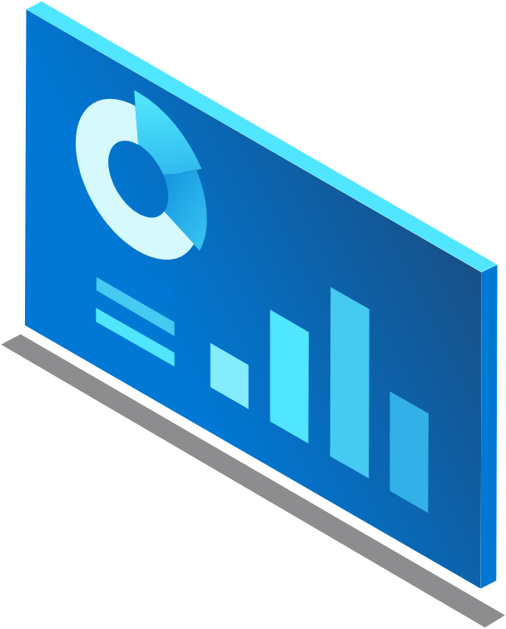



















Azure Synapse Link for SQL
Simplified experience
Centralized data
Near real-time insights
Minimized overhead
With a streamlined setup, transfer data from operational systems seamlessly
Consolidate data from multiple sources into a single analytics solution
Maximize impact with automated systems, capturing and updating data in near real-time
Record data changes without stretching source systems

Slide 8
Azure Synapse Link for SQL
Automate data transfer and eliminate barriers with Azure Synapse Link for SQL
Operational Databases
Reduce latency and gain near-real-time insights with seamless data pipelines.
Simplify the multi-step process of extracting, transforming, and loading (ETL) data.
Apply Azure Synapse Analytics to various data sources whatever their size, scale, and format.
Gather impactful insights through hybrid transactional and analytical processing with minimal impact on operational systems.
SQL Server 2022
Azure Synapse Link for SQL
Azure SQL Database
Operational Databases
Azure Synapse Analytics
Notes:
Reduce latency and gain near-real-time insights with seamless data pipelines
Simplify the multi-step process of extracting, transforming, and loading (ETL) data
Create a centralized system for data analytics to house multiple source systems
Minimize impact of transactional workloads by capturing but not storing incremental data changes Azure SQL DB
Gather impactful insights through hybrid transactional and analytical processing with minimal impact on operational systems
Conveniently collect the most-up-to-date analysis at near real-time speed
Combine Synapse Analytics with various data sources despite size, scale, and format
Promptly sync with Azure Machine Learning, Spark, or Power BI for powerful analysis

Slide 9






Sample Architecture
Kubernetes Services
Azure Cosmos DB
Inference
AML
Power BI
Kubernetes Services
SQL Personalized Content
Recommendations
Real-time Recommendations
Storage Account
Data Factory
Night ETL
SQL Database
Orders
Customers
Financial Inst.
App Services
SQL
Inference
Customers
Financial Inst.
App Services
SQL
Synapse Link for SQL
Near Real-time
No Managed ETL
No OLTP Perf
Simple pricing for Link
Azure Synapse Dedicated Pool
Built-in AML
Power BI
Reporting and Analytics
Complexity - ETL jobs, management, costs
Scoring streaming
Batch
Operational complexity around ML
Performance
BEFORE
AFTER
Notes:
Everything in blue box gets simplified into the green box
Before:
-Cost complexity associated with managing an ETL
-Operational complexity
-Latency
After:
-Simple pricing for Link
-No complexity because you’re not managing an ETL
-Near real-time

Slide 10


“Synapse Link for SQL Server 2022 helps us to seamlessly replicate operational data in near real time to be able to have more powerful analytics.”
-Javier Villegas, IT Director for DBA and BI Services, Mediterranean Shipping Company

Slide 11


“With SQL Server 2022 and the arrival of Synapse Link, we can finally achieve near real-time analytics over our most important data, all without the need to build and manage complex packages and pipelines.”
-Nic Hopper, Data Architect, Atrium Underwriters

Slide 12
Resources for Azure Synapse Link for SQL
Documentation
Azure Synapse Link for SQL
What is Azure Synapse Analytics?
Social
Announcing Azure Synapse Link for SQL (blog)
Announcing the SQL Server 2022 Public Preview (blog)
Follow @Azure_Synapse on Twitter for the latest updates

Slide 13
Demos: Azure Synapse Link for SQL
Build 2022: Azure Synapse Link for SQL – Chuck Heinzelman
Build 2022: Modernize your applications with new innovations across SQL Server 2022 and Azure SQL

Slide 14
End

